Slide 1
Automotive industry in Japan
CIT 180 - Alexies Farinas

Slide 2
Introduction
Japan is known for its booming automobile industry.
It is one of the world’s most successful car manufacturers.
Japan has been in the top three of the countries with most cars manufactured since the 1960s.

Slide 3
Database
This database is used to be more informative purposes.
This database is used specifically for the automotive industry in Japan.
This will provide information of the manufacturers in Japan along with
The car type
Car model
Car detail of the car model .
This is useful for the automobile industry, because it provides the information on what cars models have already been created in Japan.
Not only will is it informative, but this can also actually be helpful for other automotive industries
Prevent copyright on model names
Change of transmission, weight, mpg, etc. for different body types

Slide 4
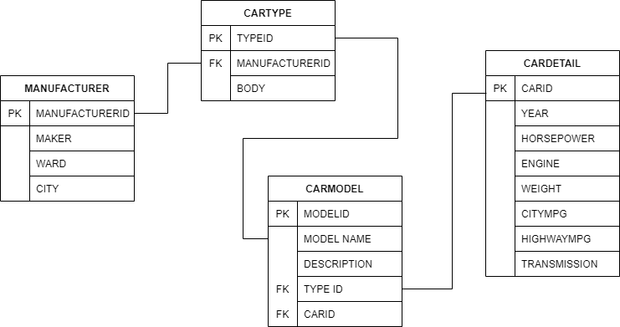
CONCEPTUAL MODEL
The lines in the model will indicate the relationship between the tables
PK will indicate the Primary Key
FK will indicate the Foreign Key
Car Type references Manufacturer
Car Model references Car Type
Car Model also references Car Detail

